Slide 1

Planning And Managing Document Assembly Projects
Quinten Steenhuis, Greater Boston Legal Services
Twitter: @QSteenhuis / nonprofittechy.com

Slide 2
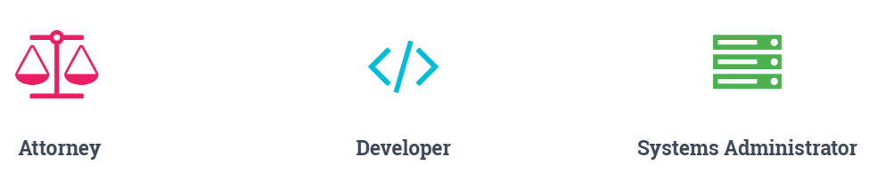
Who am I?
Notes:
Background at CMU:
CS but not CS
Learned PHP: student senate, online elections, printing and publications, Indymedia (open publishing).
Interested in social justice
Did not see connection between tech and social justice
Law school:
Nobody doing tech
GBLS:
Nobody thinking about tech + law
Automated my own work but did not advertise technical skills
Crash = need new sysadmin
Still hid each skillset from the other world
Only recently user-facing:
WriteClearly, Case management, HRIS, e-discovery. Custom built is not always the right choice

Slide 3
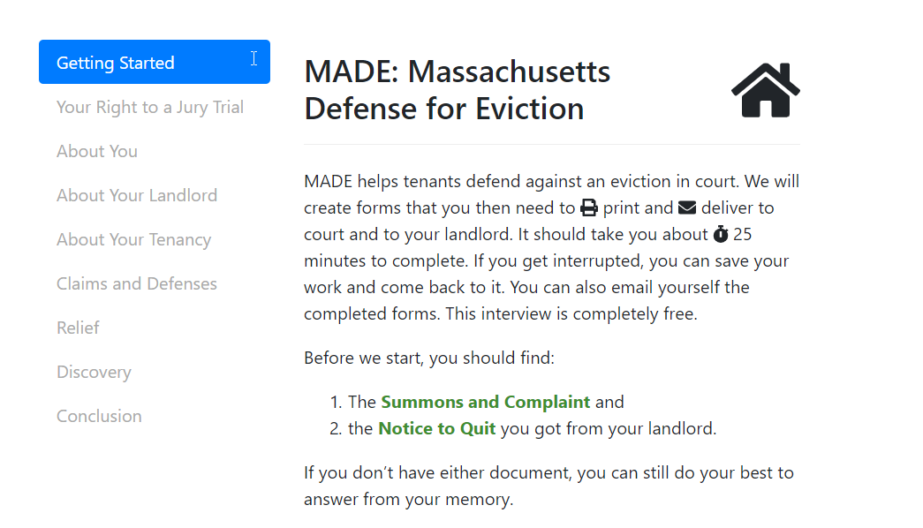
Demo

Slide 4

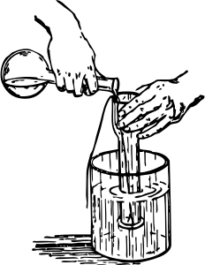


Analyze
Test
Ideate
Build

Slide 5
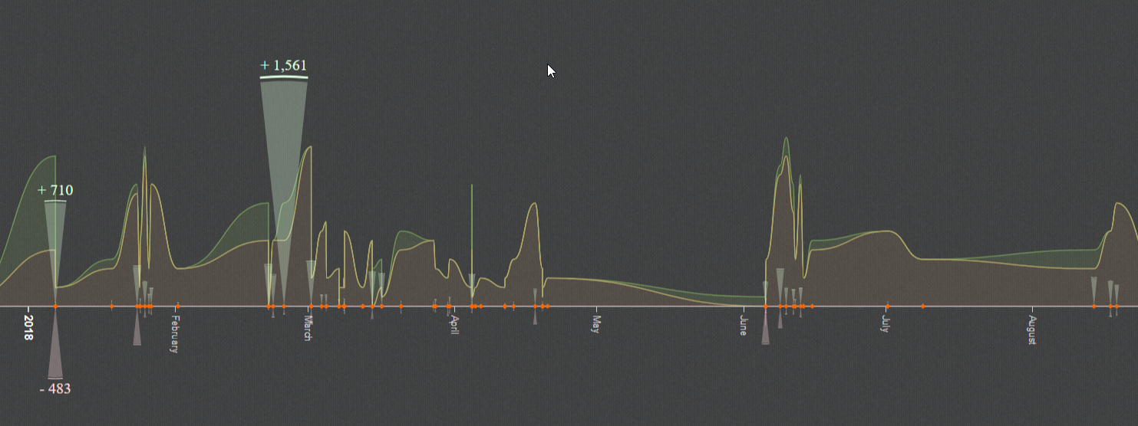
Additions, Deletions, REvisions

Slide 6
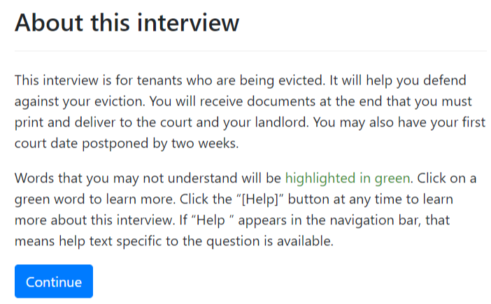
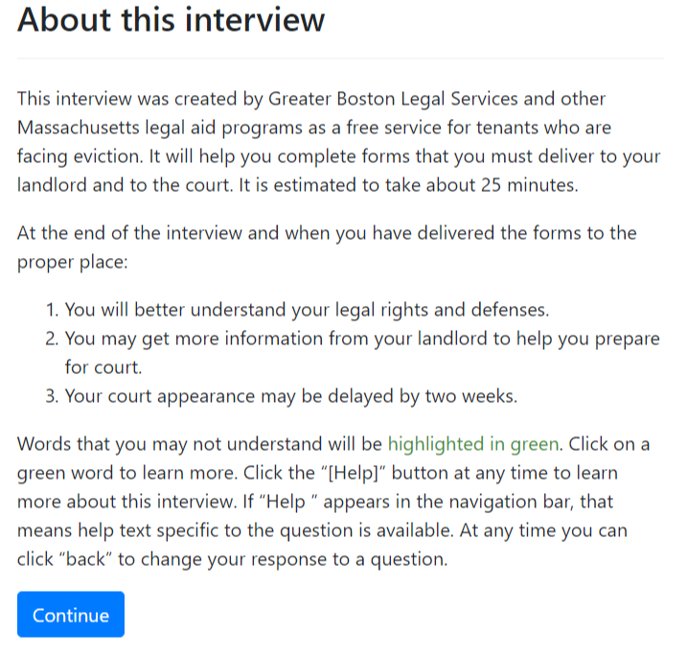
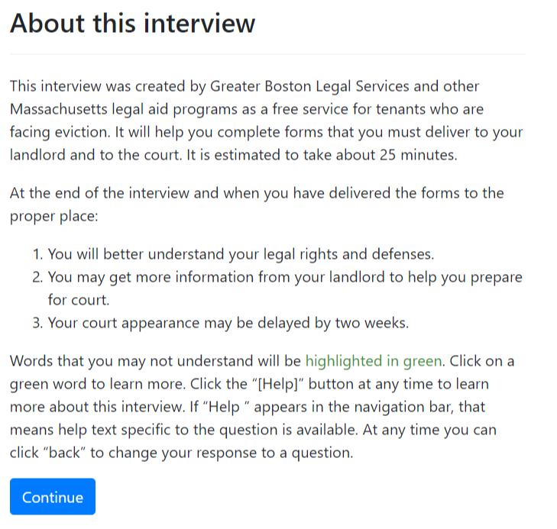
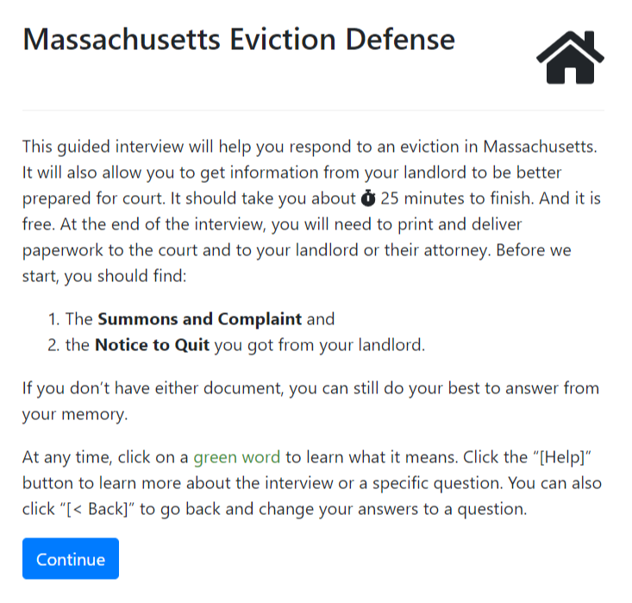
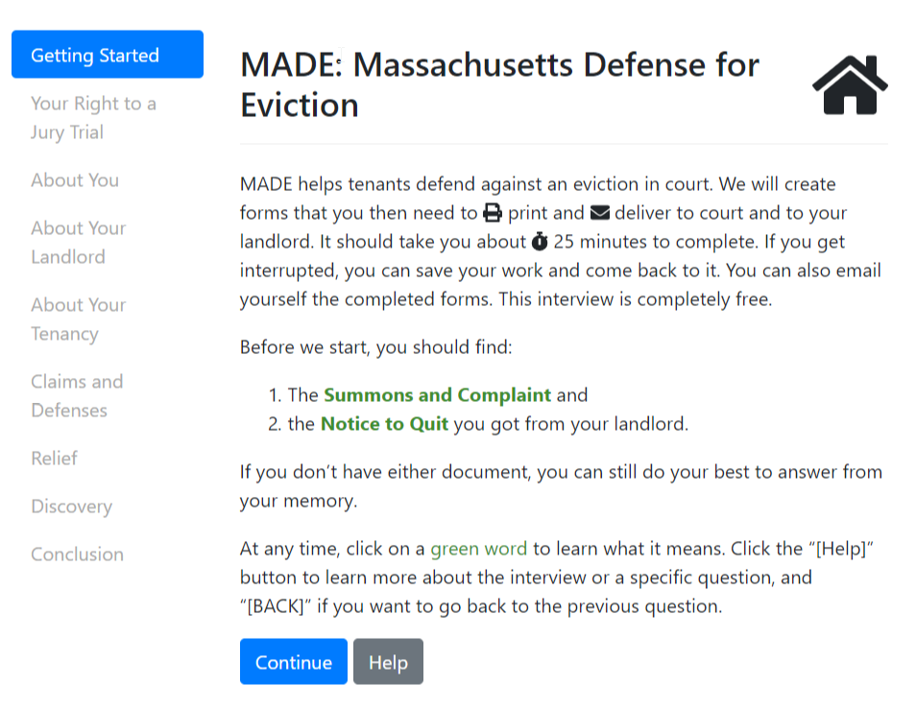

Slide 7
Key Tools for Project Management
Spreadsheet or Word document
Issue tracking or todo list
Version control (Git)
Kanban or Gannt for multiple collaborators

Slide 8
Complexity and size of project
Word or Excel
To-do list
Issue tracker
Version Control
Kanban
Gantt Chart

Slide 9

Why use Version Control?
Backup work
Isolate bugs
Iterate without breaking
Historical record
Collaborate

Slide 10
What does Version Control Look Like?
Draft Code
Commit Changes
Publish Final Version
Restore to Point in Time
Revise code
Commit Revisions

Slide 11
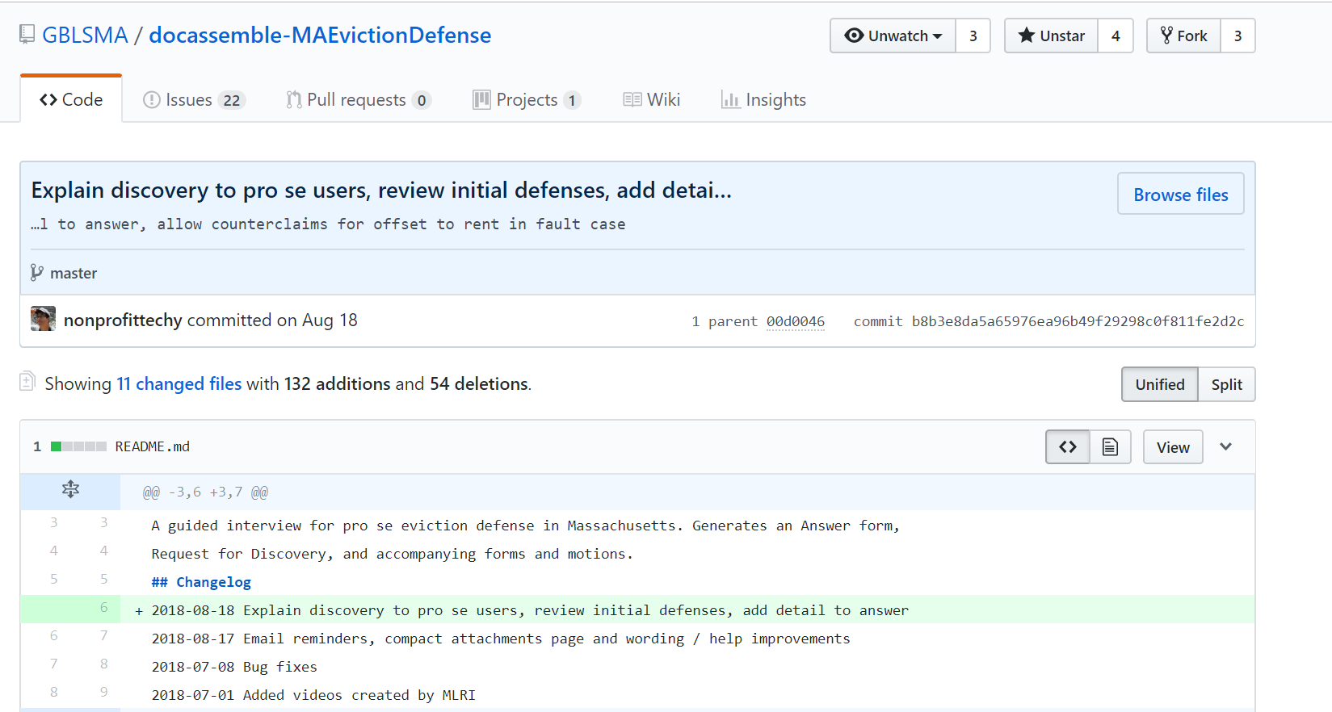
Example

Slide 12
More Information
Web: Nonprofittechy.com Twitter: @QSteenhuis

